Slide 1

Tech career & interview tips
Andrew Oakley support & devops manager, senior information risk officer, blueberry, stonehouse near stroud
andrew.oakley@blueberrysystems.co.uk
Notes:
These presentation slides are very wordy.
It was written in 2021 during the Covid pandemic, and there was a risk it might not be delivered in person, so the idea is that the slides have enough detail to make sense on their own.
Also I wasn’t sure about the length. The important stuff is slides 5 through 9. Slides 10 onwards are hopefully interesting, but essentially filler.

Slide 2
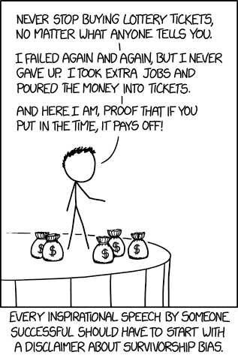
A disclaimer about Survivorship bias
I’m nice-house-and-new-car successful, but not megacorporation-CEO successful
I’ve mostly stuck to being an employee. My tips are about employed work.
I did run my own company for a couple of years. I didn’t make a loss. I learned that sales people and sales leads are very valuable, and that I am not good at finding sales leads.
Be honest with yourself about what level of risk you can afford to take, at different stages of your career.
Employed work might be your fallback plan if your startup fails
xkcd.com
Notes:
I am risk averse.
You may hear many inspirational speeches from people who took huge risks and reaped great rewards.
This is not one of those speeches.
This is a speech by a senior management salary-man with a family to support.
For every successful new company, there are dozens of failed ones. Also, a company may do well for many years, but then tail off. Tech companies go bust a lot; that is the nature of trying new things. Luckily, there’s a lot of them about, so it’s usually easy to find new work.
Make sure you’re comfortable with your personal level of risk. If the risk is high, have a fallback plan.
For example, even if you plan to set up your own company, you might find these tips about employed work useful as a fallback plan.

Slide 3
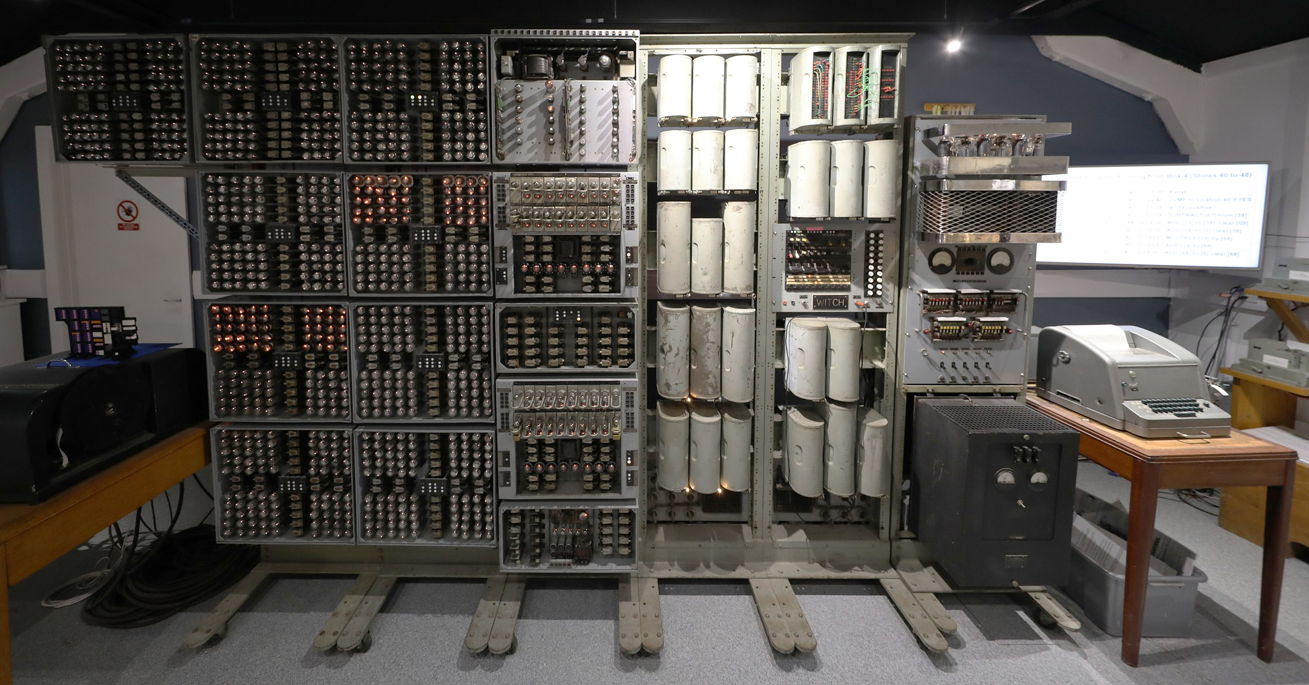
About Andrew
Born 1971. Grew up in Shropshire. Father was a maths professor. First computer I used was the Harwell Dekatron, built in 1951 for atomic research, later given to Wolverhampton University where I “used” it as a toddler in 1973.

Slide 4
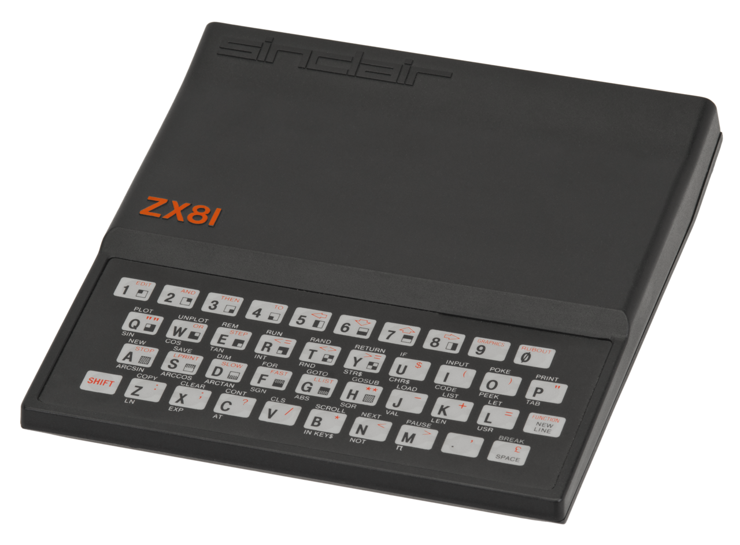
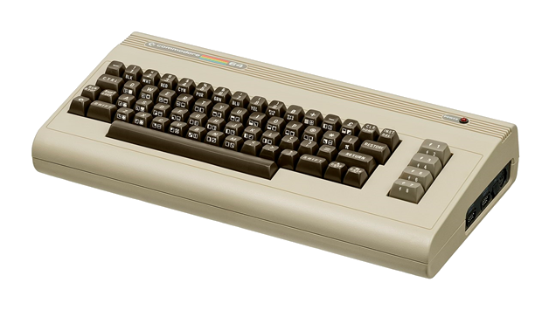

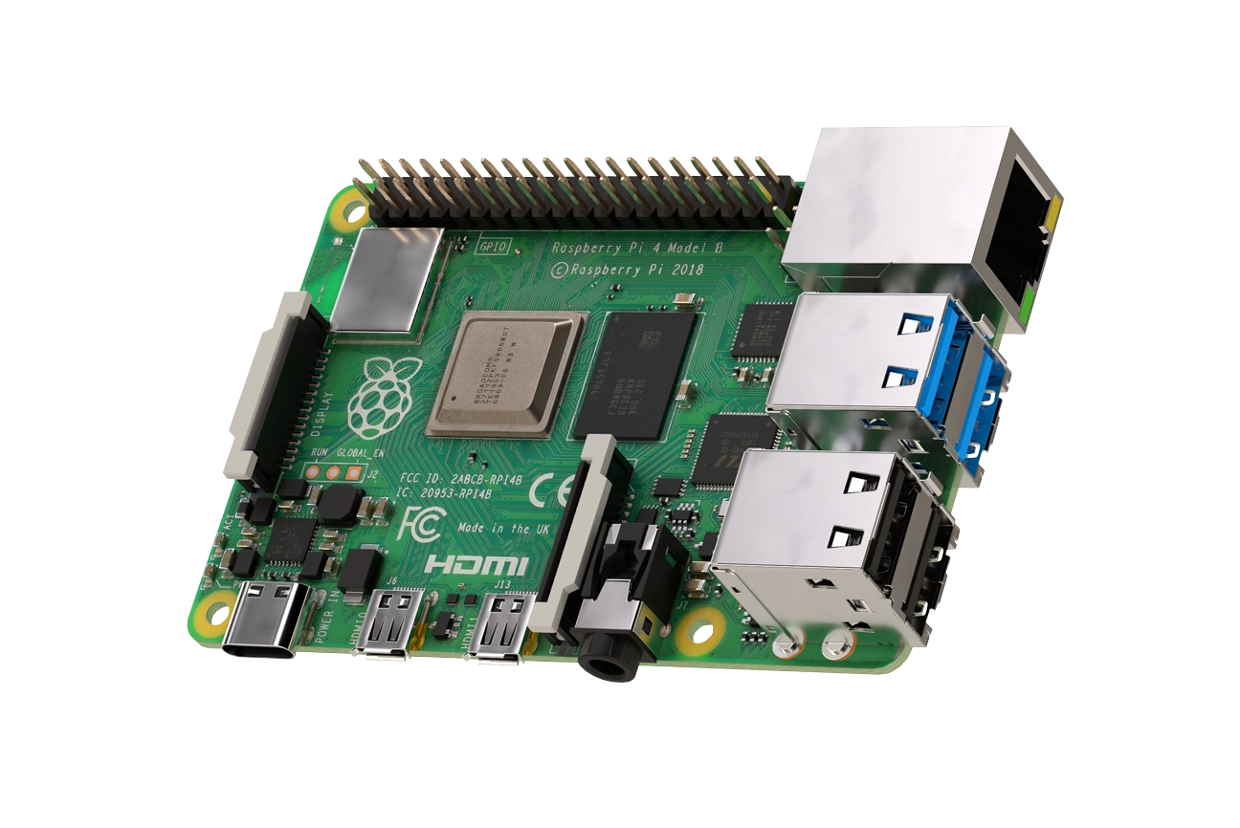
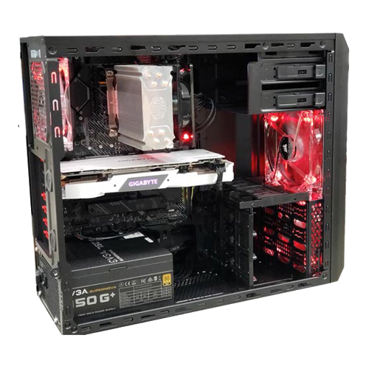
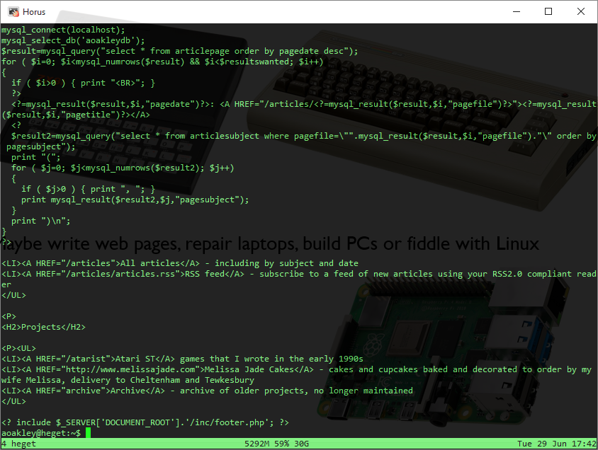
Have a tech hobby
You don’t need a maths professor dad, but it helps a lot if you have an interest in technology as a hobby.
Maybe write web pages, mobile apps, repair laptops, build PCs or fiddle with Linux

Slide 5
The top two things recruiters are looking for
Qualifications
Experience
BOTH not just one!
Early in your career, you may have qualifications, but it’s difficult to get experience.
This is where HOBBIES, VOLUNTEERING, COURSEWORK and PROJECTS help.
Ideally, have something you can show or demonstrate. Bring your laptop, tablet, photos, handouts – keep in your bag until asked, but when asked – SHOW!
Even just having something to talk about, helps enormously
Quick courses such as Amazon AWS Practitioner can be worthwhile – but research whether they’re sufficiently well-recognised compared to the cost

Slide 6
Job application process
Write a really good CV. Search for “EUROPASS” which is an excellent CV template. Use Microsoft Word .docx format – job hunting is not the time to be an open source purist (unless you’re sure it’s a Linux company)
List all the technologies you know. Every. Single. One. You are trying to get “hits” based on word matching algorithms.
Highlight anything for which you have 6 months, 1 year, 3 years or more experience.
List your qualifications, and consider adding notes about particular topics or coursework – word “hits” again
Upload your CV to every job website going. When creating a profile, be honest about your location and commute range unless you really are prepared to relocate.
Also email your CV to noted regional tech recruitment agencies, e.g. Modis Bristol, Sandersons Bristol, Red Recruitment Bristol – but avoid temping agencies, you’re not looking for maternity cover for a secretary, nor are you looking to drive a fork-lift in a warehouse.
At the very start of your career, it’s tempting to do interviews for jobs you have no intention of taking, just for the interview experience. I could not possibly comment on the morality of that.
English matters. If you don’t have at least a C / grade 4 GCSE English Language, get help. It really stands out if you can’t write in proper paragraphs or don’t know how to use apostrophes. Proof-read everything. You need to demonstrate that you can communicate well with other staff and customers, both in audio and text.
Notes:
I could do a whole lecture on writing a good CV. There are plenty of CV-writing tips out there; read up, focus on “technical CVs”.
Most likely, your CV will go through a recruitment agency.
Applying direct does sometimes work, but it often looks better if you’re recommended by a recruitment agency. Recruitment agencies usually charge 25% of the first year’s salary, billable after 3-6 months. Weirdly this doesn’t seem to be much on an incentive to hire direct; companies are usually much more comfortable using an agency. I suspect they think it’s worth paying the agency fees to filter out the time-wasters.
Later in your career, you will be hounded by recruitment agencies. Be nice when saying “no”, you never know when you might need them. A good response is “I’m not looking right now, but please keep me on your books and let’s chat again in 6 months”.

Slide 7
Presenting yourself at interview
Shirt or blouse with a proper collar
Nobody has cared about ties since the mid 1990s. Wear one if you like them, if they make you comfortable and confident. Don’t if you don’t.
Smart trousers or long skirt. Clean your shoes. If you absolutely must wear trainers, make sure they’re tidy and not flashy.
Try not to sweat! Think LAYERS. The time to switch layers is when waiting for the interview, not during the interview (but it’s better than sweating). Offices are notorious for being too hot or too cold; the temperature in the waiting area will probably be the same as the interview room. Consider a jacket / smart coat / smart jumper / smart fleece. NOT an anorak nor a hoodie – if rain is forecast, take an umbrella instead.
Your goal is to show that you can fit in. Interviews are not the time to express your individuality. Hide your tattoos.
The exception to the rule is graphic designers. You folk can be a bit more flashy, but you need to keep a professional attitude.
Talk clearly. If you’re shy or tend to mumble, sorry but you need to get over that. Practice conversations with friends-of-friends that you don’t usually talk to. “Fake it ‘til you make it”
Nobody cares about your sexuality, ethnicity, religion, gender identification, social class, politics or whatnot – it will not come up in the interview (it might come up in follow-up vetting for security work – don’t worry, relax, be honest)
Notes:
Techies can get very stressed about what to wear to an interview. If you spend most of your time with computers, you will have noticed that they never care about what you wear.
School uniform does not set a good example. Managers of fast food restaurants wear ties, almost nobody else wears ties. In particular, nobody wears a tie over a polo shirt.
“Fake it ‘til you make it” is not a joke. I am not naturally a chatty, gregarious person. The persona you’re hearing during this presentation is fake. Quite frankly I’d rather be at home, on my own, in my study.

Slide 8
Expect the expected
You will be asked about:
Your qualifications – be prepared to talk about coursework, projects and topics covered
Your experience – especially “tell me about things you’ve done that are relevant to this role”
How you’d handle a hypothetical scenario, e.g:
Difficult customer
Technical challenge
Handling an impossible-to-win situation / Under what circumstances would you ask for help?
How will you commute to the location?
Do not underestimate the importance of this question
“The train” will be very unconvincing unless you and the job are both in a very big city
“I’m prepared to relocate after the probation period” is a good answer
“I drive a car” or “I’m taking driving lessons” are the most reassuring answers, whether you like it or not
“I’ll get a lift with someone” is the absolute worst answer. They’re hiring you, they’re not hiring your friend.
“I’ll work from home” – check whether that’s actually an option, before you use this one
It’s okay to bring notes! I often bring a print-out of my own CV.
Notes:
“They’re hiring you, they’re not hiring your friend” applies to many answers you might give. When talking about college projects or coursework, be bold about saying which parts you had the most hand in.

Slide 9
Sometimes, you’re interviewing them
There are more tech vacancies than there are suitable people to fill them
Don’t be picky about your first tech job
Don’t be picky about your next job if your current employer is going bust – going bust happens A LOT in tech, it’s all part of companies trying new things
Otherwise, YOU CAN BE PICKY, so long as you’re also realistic.
“Interview the interviewer” – prepare some questions; they’re not just there to fill an awkward silence, they can tell you whether this job might be better than another job
How long has the company been going?
How big is the company? Rough number of employees?
Who are the typical customers?
What new technologies are they looking towards in the future?
What is the typical career path for this role?
Notes:
Does the job suit you?
Is the company going to last long enough to pay your salary?
Is this somewhere you’re looking to stay and grow your career, or is it just a stepping stone?
Do you care about benefits such as pension or private medical?

Slide 10
Andrew’s career path
Home computing as a hobby in the 1970s and 1980s
Mid 1980s teenager - Summer job preparing master copies for home computer games at a cassette tape duplication plant (today you might consider contributing supporting material to someone else’s project – e.g. documentation, website)
Late 80s / early 90s sixth form & university - Wrote articles and “cover disk” games for computer magazines (today you might consider keeping a blog or writing small apps)
1992 University sandwich placement, year out at IBM Warwick, mostly in the finance department.
1993 IBM sponsored me to do my final year project, and gave me a tower PC
1994-2000 worked as a database / C programmer for finance industry in Cheltenham
Y2K bought me a nice new 4x4
2000-2005 switched to web coding, back-end database integration, Tewkesbury & Cheltenham – including 2 years running my own small software development firm
2005 onwards switched to management as head of anti-spam at MessageLabs / Symantec, Gloucester
2010 software development project management at Higher Education Statistics Agency, Cheltenham
2015 project management then Head of Support / DevOps / SIRO at Blueberry, Stroud
andrew.oakley@blueberrysystems.co.uk

Slide 11
Andrew’s current role
Support manager
Managing 1st line support analysts
Handling problem issues; issue escalation and prioritisation
Managing offshore coders
DevOps manager
Managing DevOps staff
Planning ecosystem / infrastructure – AWS, Gitlab
Senior Information Risk Officer
GDPR
Ensuring we are compliant with regulations and best practice, particularly in the healthcare sector
andrew.oakley@blueberrysystems.co.uk

Slide 12
Andrew’s outside interests
I run (ran?) Cotswold Jam, a Raspberry Pi enthusiast group focussing on teaching junior-age children to code. Approximately 120 attendees, five times a year at Gloucestershire University, from 2015-2020.
During the pandemic, I refurbished laptops for lockdown pupils. Lots of people donated old laptops, I tidied them up, upgraded RAM, put in a small donated new SSD, and installed Debian with Raspberry Pi Desktop.
Music is quite mathematical, it helps you think logically and in sequence. In theory I’m a qualified piano teacher, in reality I mess about with synthesisers.
Married with 3 children, 15 year old daughter, 11 year old mixed twins. This colours my view of risk.
Notes:
I was never that keen on risk even before I had a family, to be quite honest.

Slide 13
BLUEBERRY
Around 200 staff around the world, of which about 50 in the UK
Blueberry Systems
One-off “bespoke” business-to-business websites and what used to be called “intranets” – users are usually existing staff, not the public
Approx. 20 project managers, support and DevOps staff, based in Stonehouse near Stroud
Usually offshore software developers but we have started onshoring in 2021
Usually C#.NET and Angular.js – we also have our own templating libraries
Usually Microsoft Windows Server & IIS, sometimes Linux & Nginx, sometimes serverless
Usually with a database, MS SQL Server or MySQL / MariaDB
Usually integrated with one or more APIs – factory production line, management reports, stock control, forecasting, torque measurement of safety bolts on cars, IoT sensors, adjusting the chemical formula of asphalt…
Blueberry Healthcare
A new company we’re setting up ; separate from Systems to handle the more restrictive regulations and needs of the health sector
Blueberry Consultants / Blueberry Software
Sister company in Birmingham focussing more on non-web software, e.g. desktop, embedded
andrew.oakley@blueberrysystems.co.uk

Slide 14
Let me reassure you about offshoring
GDPR and similar regulations mean that fewer and fewer software development roles are suited to offshoring
Russian and Asian offshoring is getting more expensive
Brexit means that even offshoring to the EU is fraught with uncertainty (although GDPR “adequacy” announcement of 29 June 2021 may reduce this uncertainly)
In 2021, Blueberry has hired its first UK-based onshore software developers in many years
This is a good time to start a UK software development career
andrew.oakley@blueberrysystems.co.uk

